Slide 1
The Enigma Simulator
Elliot Brooks
Notes:
Hello, my name is Elliot and this is a video about my project : The Enigma Simulator.

Slide 2
In this video :
Motivation & Context
Aims
Enigma Roleplay
Notes:
In this video, I will cover the motivation and context surrounding this project – provide its aims – as well as provide a demonstration of the project through roleplay

Slide 3
Is this you?
Secret messages?
Protected Data?
Cryptography!
Since 1800 BCE
[ TODO : Some old looking photo ]
Notes:
Before we begin, let me ask you a question : Have you ever wanted to keep your messages? Or ensure that your personal data is kept secret? If the answer is yes, then you are not alone!
Cryptography has been used for data protection and secret communications throughout history. Dating all the way back to 1800 BCE!

Slide 4
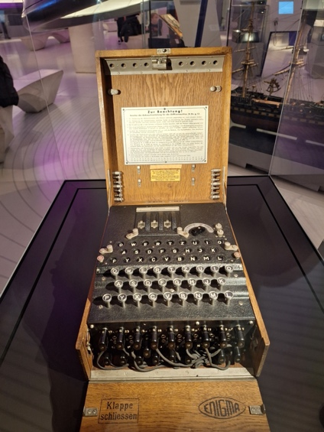
The Enigma Machine
History
A Cypher Machine
Mechanical rotors
Electrical Signals
Encrypts/Decrypts messages
Extensive History
Used by Germans in WW2
Cracked by the Bletchley Park team!
[TODO Picture of Alan T.]
Notes:
The Enigma machine is a huge part of the of history, for both computer science and cryptography, using mechanical rotors and electrical signals to encrypt and decrypt messages
It was used extensively by the Germans in WW2 and is most well-known for the eventual breaking of Enigma by the team at Bletchley Park. Hi Alan!

Slide 5
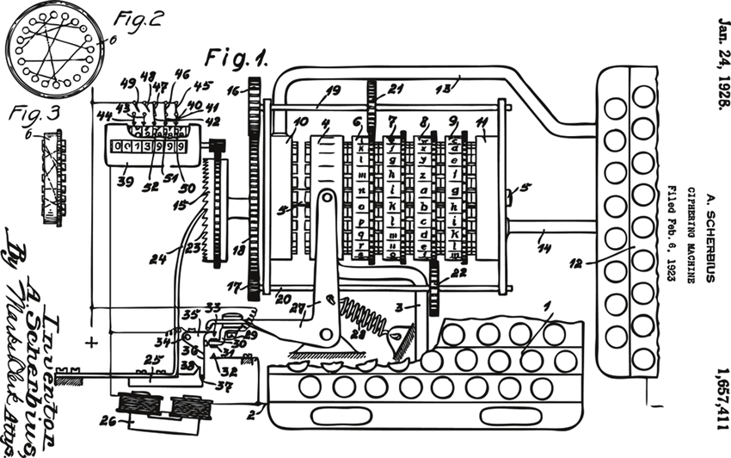
?
?
?
Notes:
Despite the fame surrounding this machine, the mechanism of Enigma still remain a mystery/enigma to most.

Slide 6
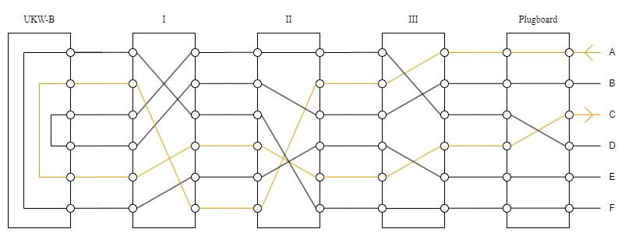
How does Enigma work?
Electrical Signals
Mechanics
Keyboard
Plugboard
3x Rotors
Reflector
Lampboard
Rotors rotate every keypress
Causing wiring to change
Causing letter mapping to change
One letter can be encrypted to multiple different letters in a single message!
Up to x9 letter scrambling!
Notes:
So how does Enigma work? Well, it uses a combination of mechanics and electrical signals to create a cypher than changes each letter!
The electrical signals are passed through 5 key components : A keyboard for input, A plugboard to acting as a swap cypher, 3 rotors which act as substitution cyphers and exhibit additional mechanical properties, a reflector which also acts as a substation cypher “reflecting” the electrical signal in the opposite direction, and finally the lampboard to display the cyphertext
The mechanics behind enigma cause the rotors to rotate each keypress, this changes the path each electrical signal will take through Enigma, therefore inducing a change in the letter-to-letter mapping of the cypher.
This creates a unique effect, where one letter can be encrypted to multiple different letters in a single message.

Slide 7
Cryptography!
Subtitle

Slide 8
Chart

Slide 9
Table
 | Category 1 | Category 2 | Category 3 | Category 4
Item 1 | 4.5 | 2.3 | 1.7 | 5
Item 2 | 3.2 | 5.1 | 4.4 | 3
Item 3 | 2.1 | 1.7 | 2.5 | 2.8
Item 4 | 4.5 | 2.2 | 1.7 | 7

Slide 10

The way to get started is to quit talking and begin doing.
Walt Disney

Slide 11
Team
Name Title
Name Title
Name Title
Name Title

Slide 12
Timeline
To start a presentation, go to the Slide Show tab, and select From Beginning.
1
To display Presenter view, in Slide Show view, on the control bar at the bottom left select the three dots, and then Show Presenter View.
2
During your presentation, the speaker notes are visible on your monitor, but aren't visible to the audience.
3
The Notes pane is a box that appears below each slide. Tap it to add notes.
4
If you don’t see the Notes pane or it is completely minimised, click Notes on the task bar across the bottom of the PowerPoint window.
5

Slide 13
Content
Subtitle
Subtitle
Add text, images, art, and videos.
Add transitions, animations, and motion.
Save to OneDrive, to get to your presentations from your computer, tablet, or phone.
Open the Design Ideas pane for instant slide makeovers.
When we have design ideas, we’ll show them to you right there.

Slide 14
Content
Subtitle
Subtitle
Subtitle
Add text, images, art, and videos.
Add transitions, animations, and motion.
Save to OneDrive, to get to your presentations from your computer, tablet, or phone.
Open the Design Ideas pane for instant slide makeovers.
When we have design ideas, we’ll show them to you right there.
This PowerPoint theme uses its own unique set of colours, fonts, and effects to create the overall look and feel of these slides.
PowerPoint has tons of themes to give your presentation just the right personality.

Slide 15

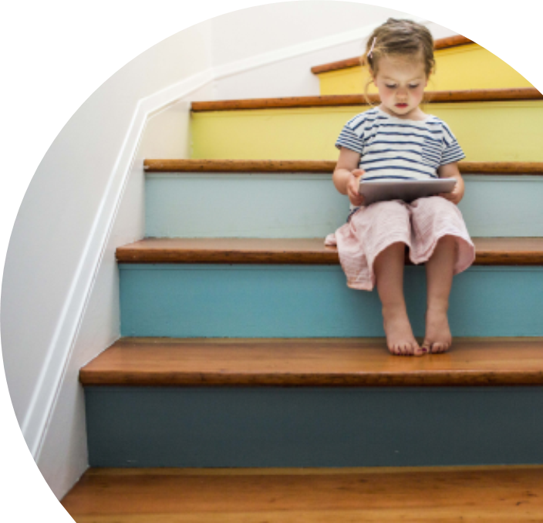
Summary
With PowerPoint, you can create presentations and share your work with others, wherever they are. Type the text you want here to get started. You can also add images, art, and videos on this template. Save to OneDrive and access your presentations from your computer, tablet, or phone.

Slide 16
Thank you
Presenter name
Email address
Website

